Slide 1


Slide 2
Transplantation in highly sensitized patients: challenges and recommendation

Slide 4
Renal transplantation is the preferred treatment of choice for patients with end-stage renal disease (ESRD) as it improves their survival, quality of life compared to dialysis. However, there is a paucity of kidney transplants performed in need of a kidney due to sensitization to human leucocyte antigens (HLA) from blood transfusions, pregnancy or a previous transplantation.

Slide 5
Within Eurotransplant, around 20% of the patients awaiting a kidney transplant is sensitized, and around 5% is highly sensitized

Slide 6
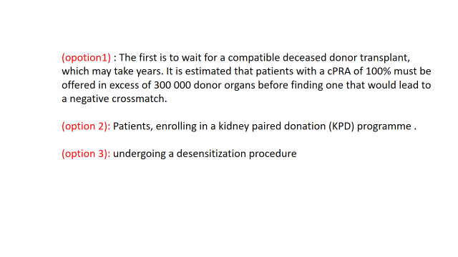

Slide 7
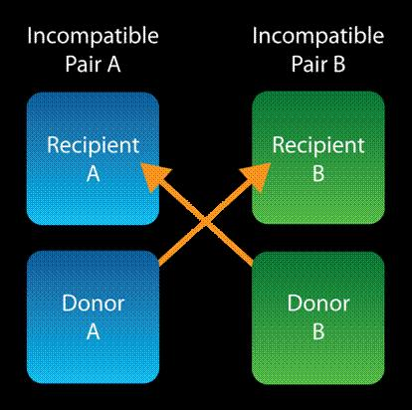

Slide 8
Survival benefit of desensitization in HLA antigen–incompatible kidney ,2011 Massachusetts Medical Society (MMS); reproduced from Montgomery et al .

Slide 9
N ENGL j med 365;4 nejm.318 org july 28, 2011

Slide 11
AJKD Vol XX | Iss XX | Month 2019

Slide 13
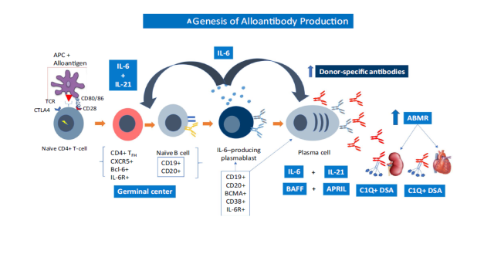
Am J Transplant. 2020;20:42–56.

Slide 14
Am J Transplant. 2020;20:42–56.

Slide 15
key requirement of the immune system is to distinguish self from non self. The life of a T cell begins in the thymus, where immature cells proliferate and create a wide repertoire of TCRs through recombination of the TCR gene segments. A selection process then begins, and T cells with strong reactivity to self-peptides are deleted in the thymus to prevent autoreactivity in a process, called central tolerance.

Slide 16
Some TCRs may have specificity that is cross-reactive with self-antigens. To prevent autoimmunity, numerous immune checkpoint pathways regulate activation of T cells at multiple steps during an immune esponse, a process called peripheral tolerance. Central to this process are the cytotoxic T-lymphocyte–associated antigen 4 (CTLA-4) and programmed death 1 (PD-1) immune checkpoint pathways.

Slide 18
CTLA-4 is a CD28 homolog with much higher binding affinity for B7; however, unlike CD28, binding of CTLA-4 to B7 does not produce a stimulatory signal. As such, this competitive binding can prevent the costimulatory signal normally provided by CD28:B7 binding. The relative amount of CD28:B7 binding versus CTLA-4:B7 binding determines ,whether a T cell will undergo activation or anergy. .
American Journal of Clinical Oncology Volume 39, Number 1, February 2016

Slide 20
In the follow-up analysis of the BENEFIT, found that recipient mortality and the graft failure rate and incidence of dnDSAs at 7 years after transplantation were significantly lower in the group of recipients treated with Belatacept compared with the control treated with calcineurin inhibitors. KTRs included in the BENEFIT, showed that the proportion and the absolute number of CD19+, CD24 ,CD38 on B cells, (a subset known to be associated with operational tolerance) are in creased compared with controls. This suggests that Belatacept may have regulatory effect on B cells . Thus, the reduced amount of DSAs observed in treated patients could at least in part rely on a direct effect on B cells independent of T cell participation..
Journal of the American Society of Nephrology J Am Soc Nephrol 29: 1049–1062, 2018

Slide 21
In conclusion, studies strongly suggests that immunosuppressive therapy using BelataCept plays a direct and active role at several steps of the humoral response. Belatacept may uniquely control B cell responses by modulating both their antigen-presenting capacities, leading to the impairment of Tfhs-B cells cross talk, and the production of antibodies by effect or Bcells.
N ENGL j med 374;4 nejm.org January 28, 2016

Slide 22
Am J Transplant. 2019;00:1–9.

Slide 24
Am J Transplant. 2019;00:1–9.

Slide 25
In this study observed a decrease in the breadth and/or strength of HLA class I antibodies as assessed by FlowPRA in belatacept‐treated patients compared to controls who did not receive belatacept. Specifically, significant HLA antibody reduction was evident for class I (P < .0009).
Am J Transplant. 2019;00:1–9

Slide 27
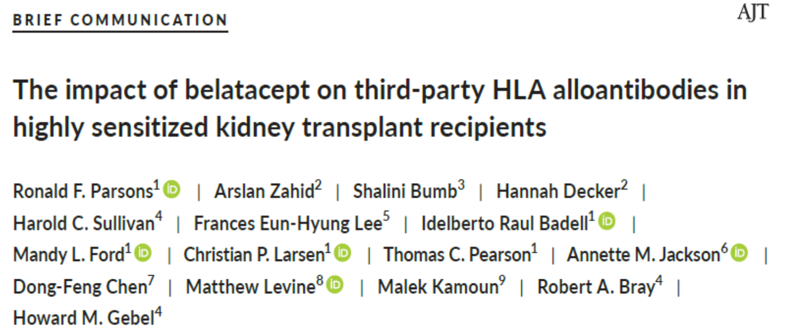
The data presented here suggest there may be another option, namely, belatacept treatment, to reduce the breadth of class I alloantibody activity and increase the likelihood of finding compatible donors
Am J Transplant. 2019;00:1–9

Slide 28
Plasmapheresis
This technique is not specific for the removal of alloantibodies and therefore all plasma proteins are reduced including clotting factors. However, this
removal is only short-lived with antibodies rebounding to pretreatment levels following re-equilibration between intravascular and interstitial compartments .More importantly, PP does not affect ongoing antibody production by plasma cells and, hence, is a poor treatment choice for desensitization as sole therapy.

Slide 29
Intravenous immunoglobulin (IVIg) derived from the gamma globulin fraction of plasma from pooled donors has been shown to inhibit T- and B-cell proliferation, cytokine production, maturation of dendritic cells, induce B-cell apoptosis and inhibit complement activation and can be divided into two general approaches: combined with alternate day PP at a low dose (100 mg/kg); or used at a high dose (1–2 g/kg).
Transplant International 2020; 33: 251–259

Slide 30
The largest single center analysis compared 8 year patient survival in 211 transplant recipients who were desensitized and underwent living donor kidney transplantation using low dose IV IG regimen with two matched control, show that survival was 90.6% at 1 year, 85.7% at 3 years, 80.6% at 5 years and 80.6% at 8 years, compared with rates of 91.1%, 67.2%, 51.5% and 30.5%, respectively, for patients in the dialysis-only group and rates of 93.1%, 77.0%, 65.6% and 49.1%, respectively, for patients in the dialysis-or- transplantation group. These data provided evidence that desensitization protocols could help overcome incompatibility barriers in live donor renal transplantation.
The authors concluded that PP/low-dose IVIG and rituximab demonstrated more success in abrogating positive crossmatch and lower acute rejection rates, but no regimen was completely effective in preventing AMR
Transplant International 2020; 33: 251–259

Slide 31
Imlifidase (IdeS) is a recombinant cysteine protease derived from streptococcus pyogenes that rapidly cleaves IgG in the lower hinge region to a F(ab’)2 fragment and a dimeric Fc fragment. The ability to cleave all IgG, including DSA, within a few hours of administration, could able to convert positive cross match to negative ,And prevent CDC and ADCC. Although other immunoglobulins (IgA, IgM, IgE, and IgD) are not affected.
Am J Transplant. 2020;20:42–56.

Slide 33
N ENGL j med 377;5 nejm.org August 3, 2017

Slide 34
N ENGL j med 377;5 nejm.org August 3, 2017

Slide 35
N ENGL j med 377;5 nejm.org August 3, 2017

Slide 36
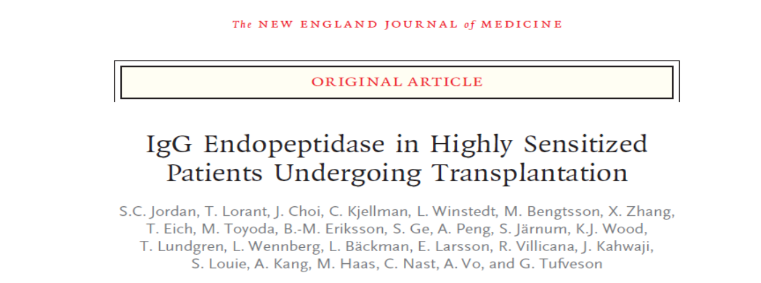
The data in this study show a significant reduction in levels of IgG HLA alloantibodies and donor specific antibodies after treatment with IdeS. The reduction or elimination of donor-specific antibodies allowed for successful transplantation in 24 of 25 patients. The single allograft loss was due to hyper acute rejection in a patient who appeared to have a non-HLA antibody
N ENGL j med 377;5 nejm.org August 3, 2017

Slide 37

Outcomes in the patients treated with IdeS in the two cohorts
were good, including similar graft survival and overall survival among patients, renal function, and incidence of antibody-mediated rejection up to 1.5 years after transplantation
N ENGL j med 377;5 nejm.org August 3, 2017

Slide 38
Complement activation is a major pathway for allograft inflammation and injury. This system is especially important in ischemia-reperfusion injury (IRI)/delayed graft function (DGF) as well as AMR/cAMR.. In addition, IRI/DGF likely contributes to B cell activation and DSA development in human renal allografts.
Am J Transplant. 2020;20:42–56.

Slide 40
www.transplantjournal.com

Slide 43
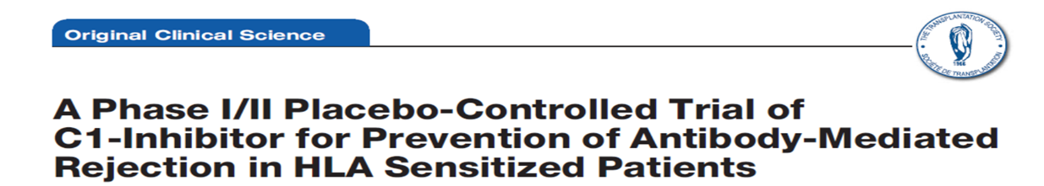

Slide 44


Slide 45
1-The C1-INH appears safe in the post transplant period.
2- The C1-INH treatment may reduce ischemia-reperfusion injury.
3-The C1-INH also resulted in significant elevations of C1-INH levels, C3, C4, and reduced C1q+ HLA antibodies. Taken together may prove useful in prevention of AMR.
Further controlled studies are warranted.

Slide 46
. Eculizumab (1200 mg) was administered intravenously approximately 1 hour (day 0)and then 900 mg on post transplant days 1, 7, 14 (± 2 days), 21 (± 2 days), and 28 (± 2 days) and 1200 mg during post transplant weeks 5 (± 2 days), 7 (± 2 days), and 9 (± 2 days).

Slide 47
Observed treatment failure rate (8.8%) was significantly lower than expected for standard care (40%; P < .001). By 9 weeks, 3 of 80 patients had experienced AMR, and 4 of 80 had experienced graft loss. At 36 months, graft and patient survival rates were 83.4% and 91.5%, respectively

Slide 48
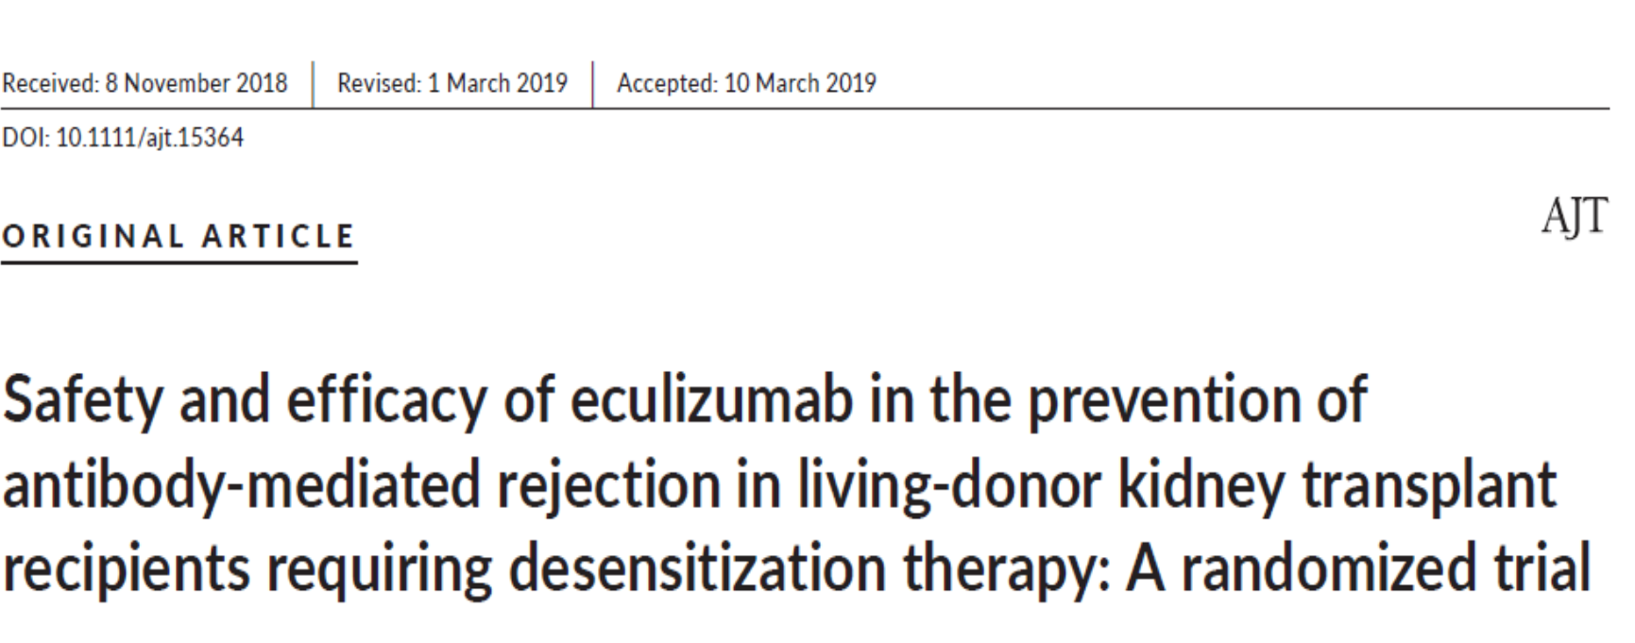
1- In a post hoc analysis including grade I AMR, the treatment failure rate was lower in the eculizumab group than in the SOC group, suggesting that terminal complement inhibition may prevent early acute AMR.
2- Graft survival at 36 months post transplant for eculizumab treated patients was 91.8% compared with 78.5% in the SOC group,

Slide 50
FC receptor neonatal ( FCRN) manipulation for treatment of A MR

Slide 51
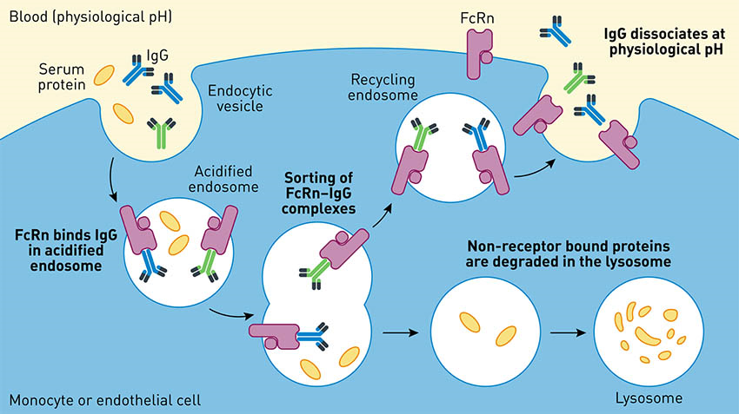

Slide 52
FcRn is a nonclassical major histocompatibility complex Class I receptor, recognized as being responsible for prolonging the half-life of circulating IgG and albumin. FcRn receptors are widely distributed in virtually all tissues of the body and especially on monocytes/ macrophages. IgG and albumin binding to FcRn is pH dependent, resulting in a significant prolongation of the half-life of these 2 important proteins. Emerging data suggest manipulation of IgG-Fc/FcRn interactions will have implications for new therapeutic approaches
Am J Transplant. 2020;20:42–56.

Slide 53
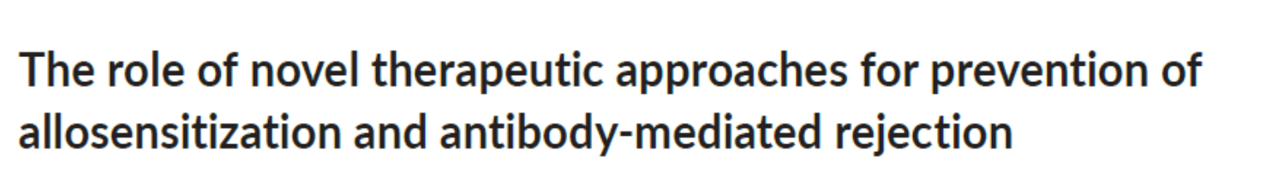
Of interest is that the system can be manipulated to obtain the opposite effect.
IgG-Fc can be engineered to enhance FcRn binding and thus extend the half-life of therapeutic monoclonals. Here, Fc mutations that enhance the monoclonal IgG binding to FcRn at pH 6.5 preferentially allows FcRn binding and recycling through the cytosol carrying their target antigens in the F(ab)′2 binding sites that are released at Ph 6.5 and degraded in the lysosome while the “refreshed” monoclonal is shuttled to the cell surface and released to the plasma with clean F(ab)′2 antigen-binding sites
Am J Transplant. 2020;20:42–56

Slide 54
Ravulizumab (anti-C5), mentioned in the complement section of this article, is the first example of a therapeutic monoclonal engineered from eculizumab to have enhanced pH-dependent binding to FcRn and antigen (C5) release in the cytosol.
Am J Transplant. 2020;20:42–56

